Slide 1

Founders:
Dan Iovino & Victoria Cusimano
Notes:
Not sure if i want to keep this figure, just added it for now

Slide 2

MISSION STATEMENT
We strive for a world where birds can recognize windows from a safe and respectful distance through thoughtful window design. Bird Barrier Solutions is committed to changing hazardous structures, collecting comprehensive data on bird-window collisions, and collaborating with architects and developers to create bird-friendly environments that respect both human needs and bird safety.
Notes:
Not sure if i want to keep this figure, just added it for now

Slide 3
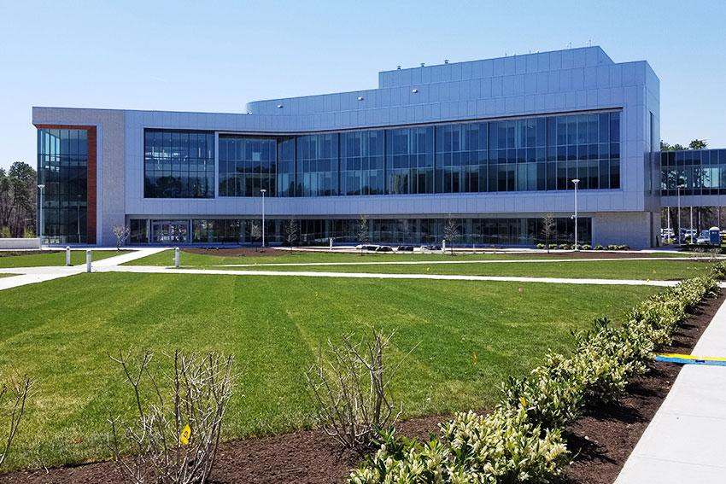

Background Information
During our time in college, we noticed an epidemic of birds dying from flying into windows. The birds were unable to distinguish windows from the air, which then caused us to start Bird Barrier Solutions LLC to create a solution for birds to avoid catastrophic collision
Notes:
Not sure if i want to keep this figure, just added it for now

Slide 4

Data Gathering
iNaturalist is a 501c3 non-profit organization that creates a citizen science platform where users contribute biodiversity observations by photograph or sound recording.
Observations may include the complete Linnaean classification, GPS locations, and dates.
Crowd-sourced data to receive help with species identifications
Notes:
Not sure if i want to keep this figure, just added it for now

Slide 5
Types of Data Collected:
Bird species information (species, taxonomy)
Location data (GPS coordinates, place descriptions)
Time information (date, time of day)
Cause of death when identifiable
Observer information (for verification)
Notes:
Not sure if i want to keep this figure, just added it for now

Slide 6

Data ETL Pipeline
Server Backup
AWS Server Backup
Data Source
Staging Area
Data Warehouse
INaturalist (Dead Bird Project)
Jupyter Notebook
SQL Workbench
Extract Raw Data
Load Prepared Data
Analyze
Notes:
Not sure if i want to keep this figure, just added it for now

Slide 7
Data Cleaning Process:
The dataset was cleaned to remove observations not within the United States.
Observations were filtered for “Research Grade” observations
observations that are confirmed by an identifier or subject matter expert.
NaN values were changed to empty strings for easier database design
Dates and Times were standardized to US EST
Notes:
Not sure if i want to keep this figure, just added it for now

Slide 8
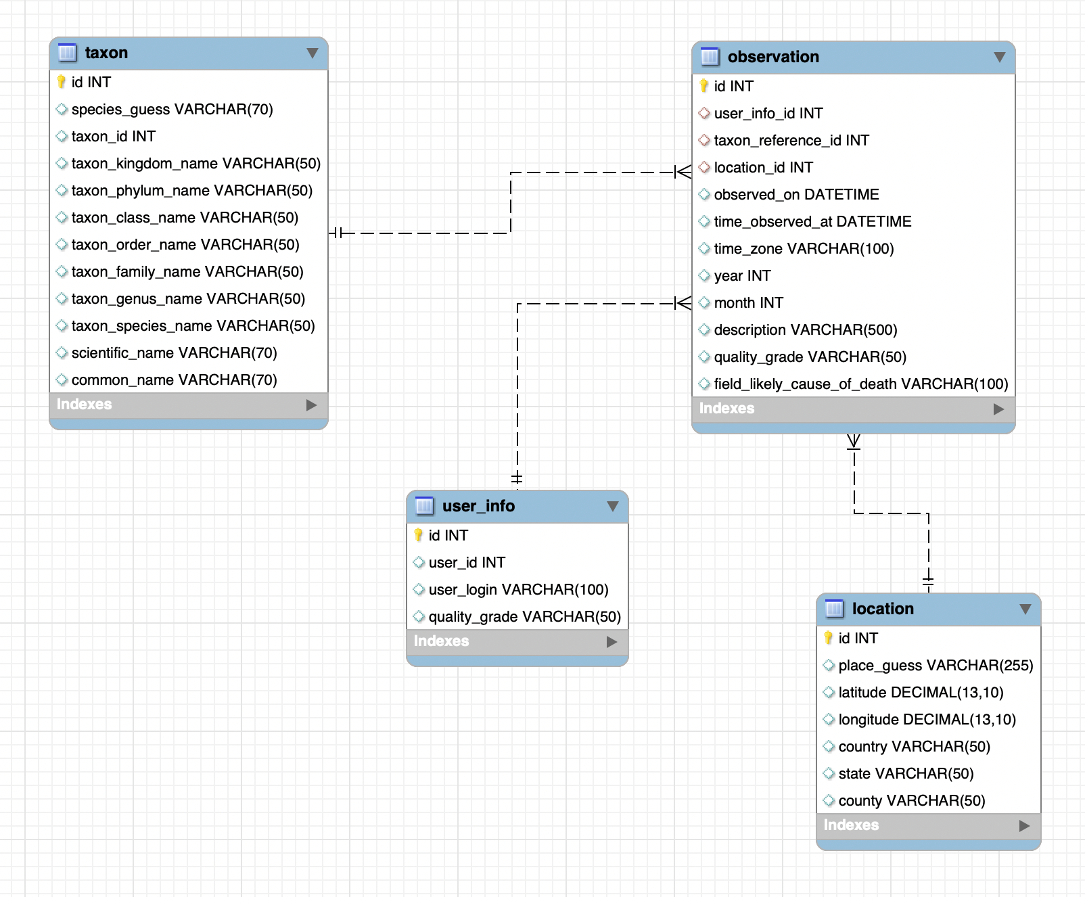
Database Schema Design
Notes:
Not sure if i want to keep this figure, just added it for now

Slide 9
Data Quality Checks
Consistency Checks:
Standardize date/time formats across all records
Check that taxon relationships are valid (species belongs to correct genus, genus to correct family, etc.)
Ensure the cause of death categories follow a controlled vocabulary
Duplicates Detection:
Identify potential duplicate observations (UUID, same species, location, date, observer)
Notes:
Not sure if i want to keep this figure, just added it for now

Slide 10
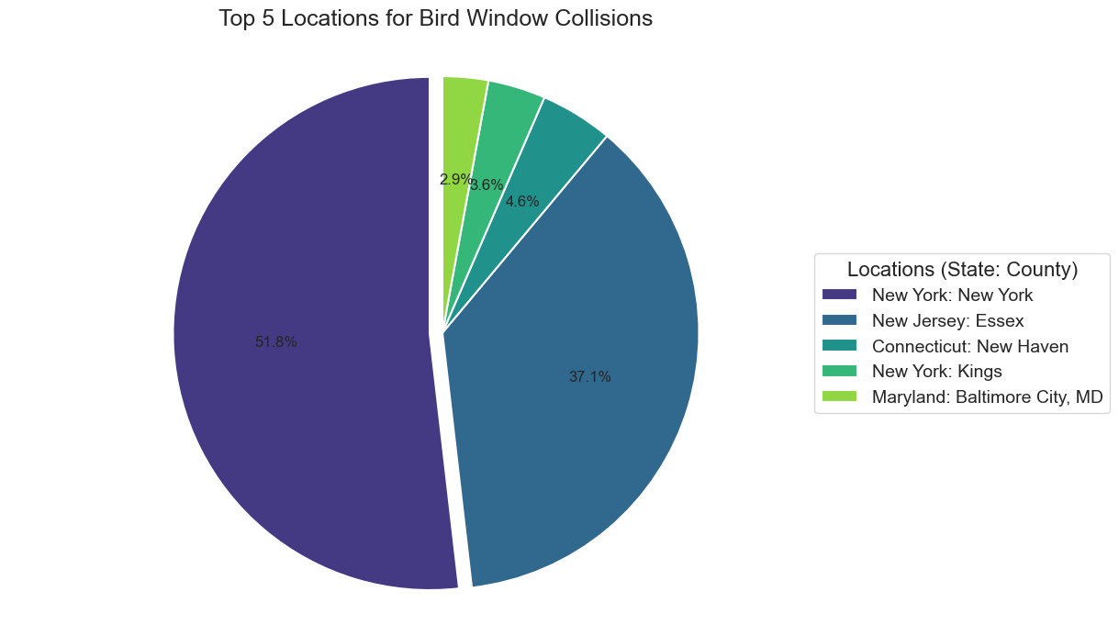
Where are we seeing the most casualties?
Figure 1: The five most frequent locations for window strikes in the United States, by state and county, from the iNaturalist Project "Dead Birds
Notes:
Not sure if i want to keep this figure, just added it for now

Slide 11
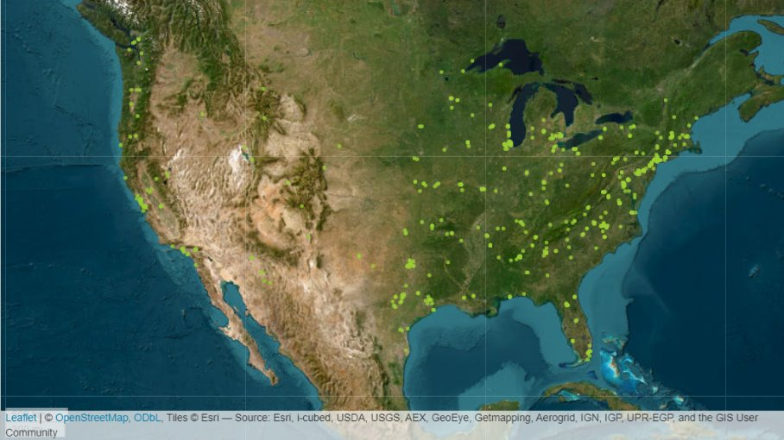
Figure 2: Geospatial locations of all 4,855 bird strikes within the United States, from the iNaturalist project "Dead Birds"
Notes:
Not sure if i want to keep this figure, just added it for now

Slide 12
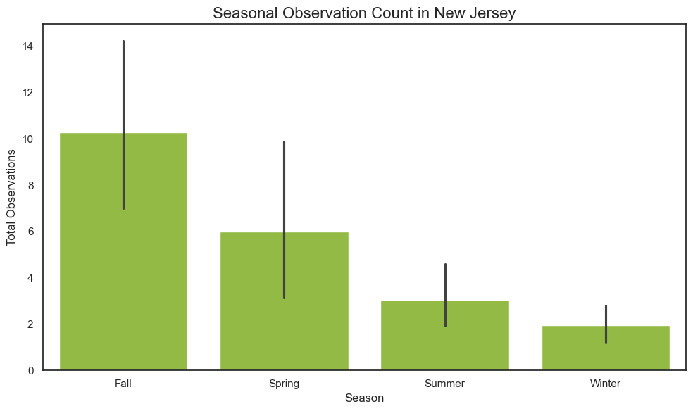
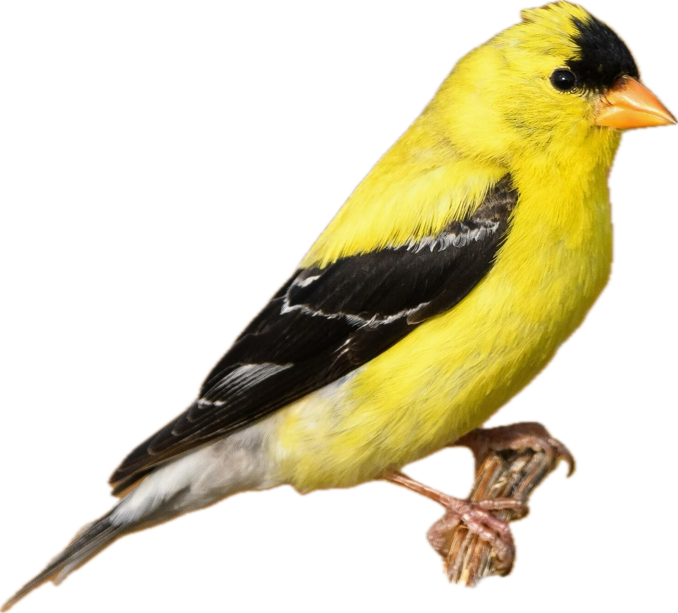
What months are we seeing the most Casualties?
Figure 3: Observations of window strikes in the state of New Jersey based on season, from the iNaturalist project "Dead Birds"
Notes:
Not sure if i want to keep this figure, just added it for now

Slide 13
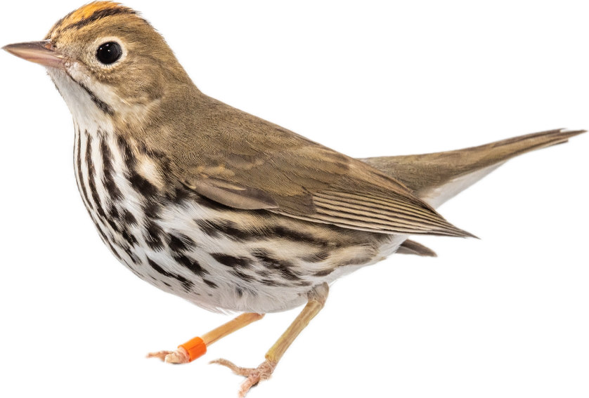
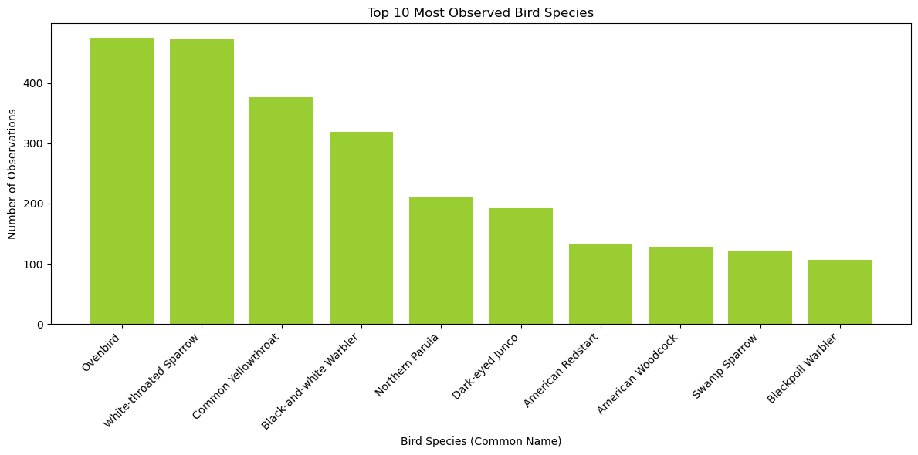
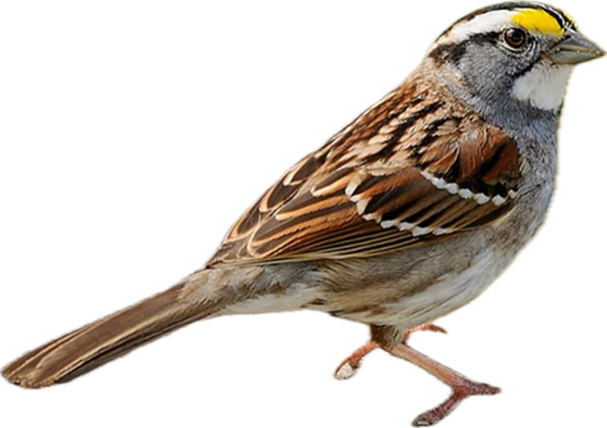
What species has the highest death count?
Figure 4: The top ten most observed bird species post-mortem within the United States, from the iNaturalist project "Dead Birds"
Notes:
Not sure if i want to keep this figure, just added it for now

Slide 14
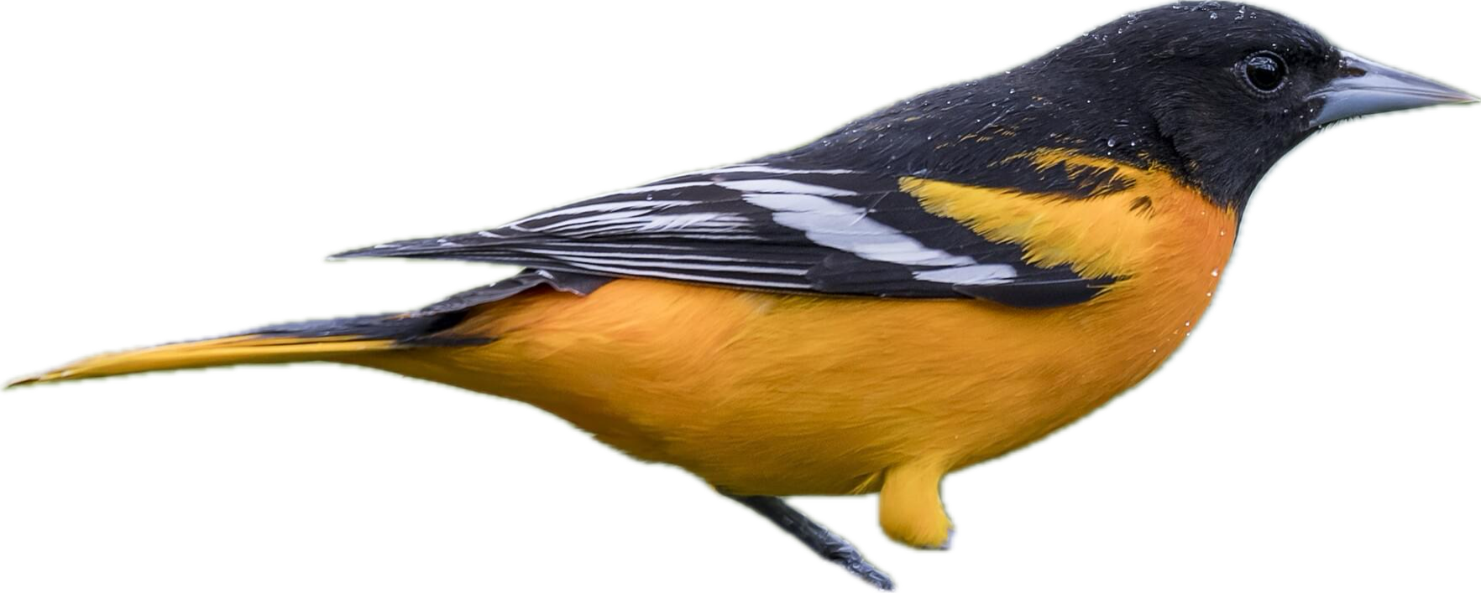
So why is this important?
One of the leading causes of avian death in modern society is window collisions.
A bird's inability to separate glass surfaces from open space presents a higher risk of mortality in highly populated and urban regions.
Our company seeks to lower this casualty rate by providing our feathered friends with a much-needed assist.
Data suggests high number of collisions in metropolitan area
High number of collisions during migratory seasons
The Brid Barrier Solutions Window Treatment© process provides the everyday homeowner or business owner, with the satisfaction of a bird-safe domicile, as well as a safety guarantee for all nearby birds.
Notes:
Not sure if i want to keep this figure, just added it for now

Slide 15


Additional Resources
Link to the iNaturalist Project: Dead Birds · iNaturalist
Link to column header information:
Terminology · iNaturalist
Notes:
Not sure if i want to keep this figure, just added it for now

Slide 16

Links and Contact
Victoria Cusimano
Link for Victoria's Github
Dan Iovino
Link for Dan's Github
Notes:
Not sure if i want to keep this figure, just added it for now

Slide 17

Questions for Investors??
($$$$$$$)
Notes:
Not sure if i want to keep this figure, just added it for now

